Slide 1

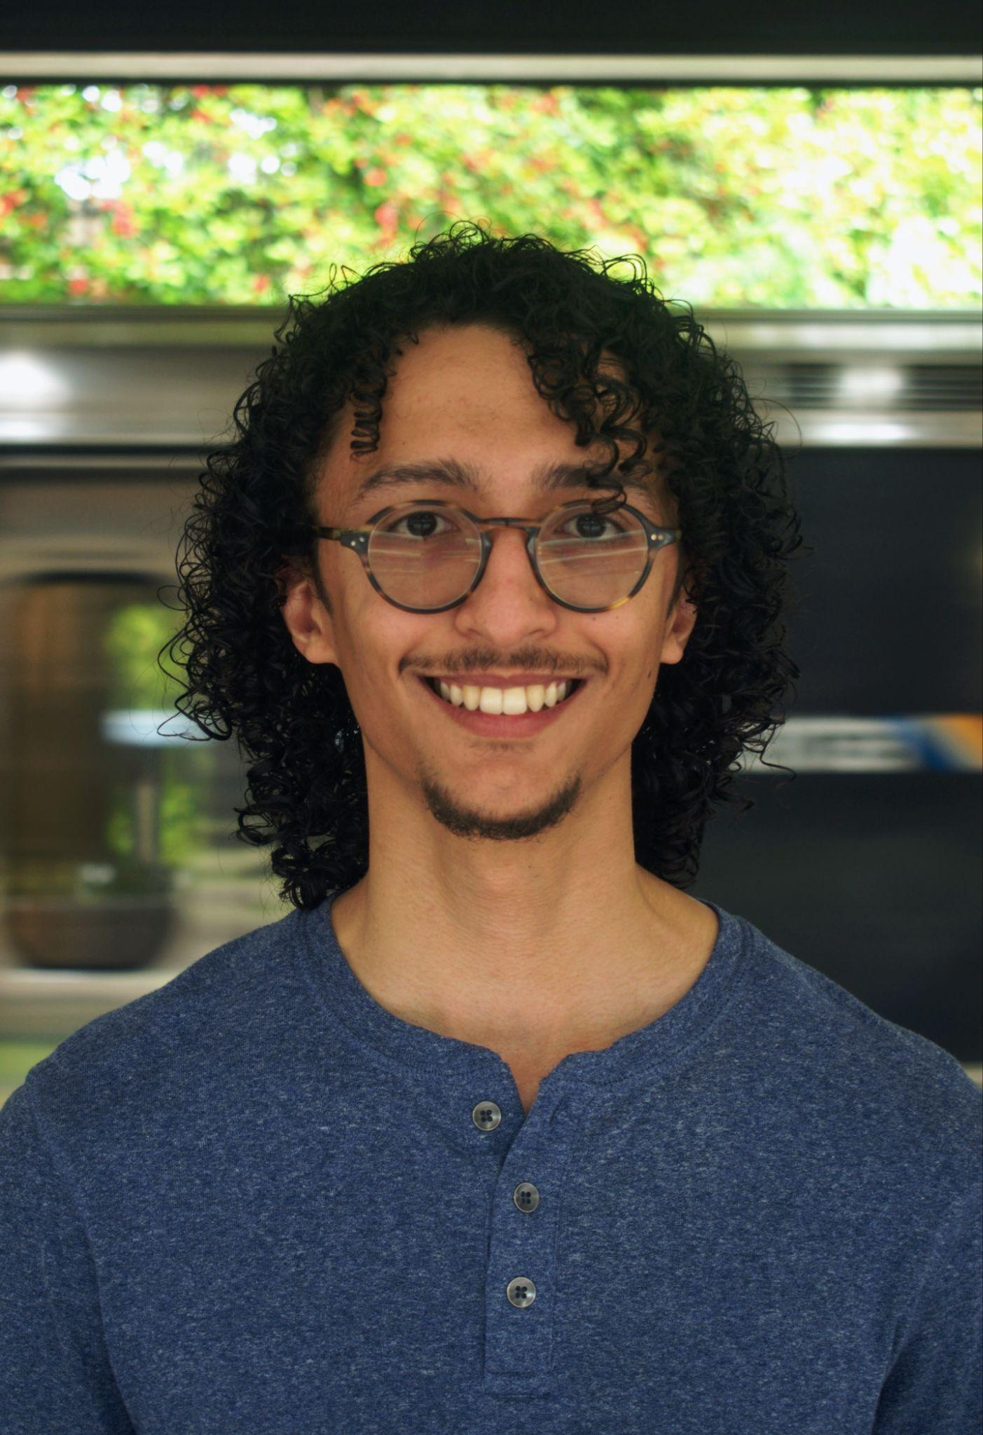
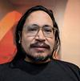

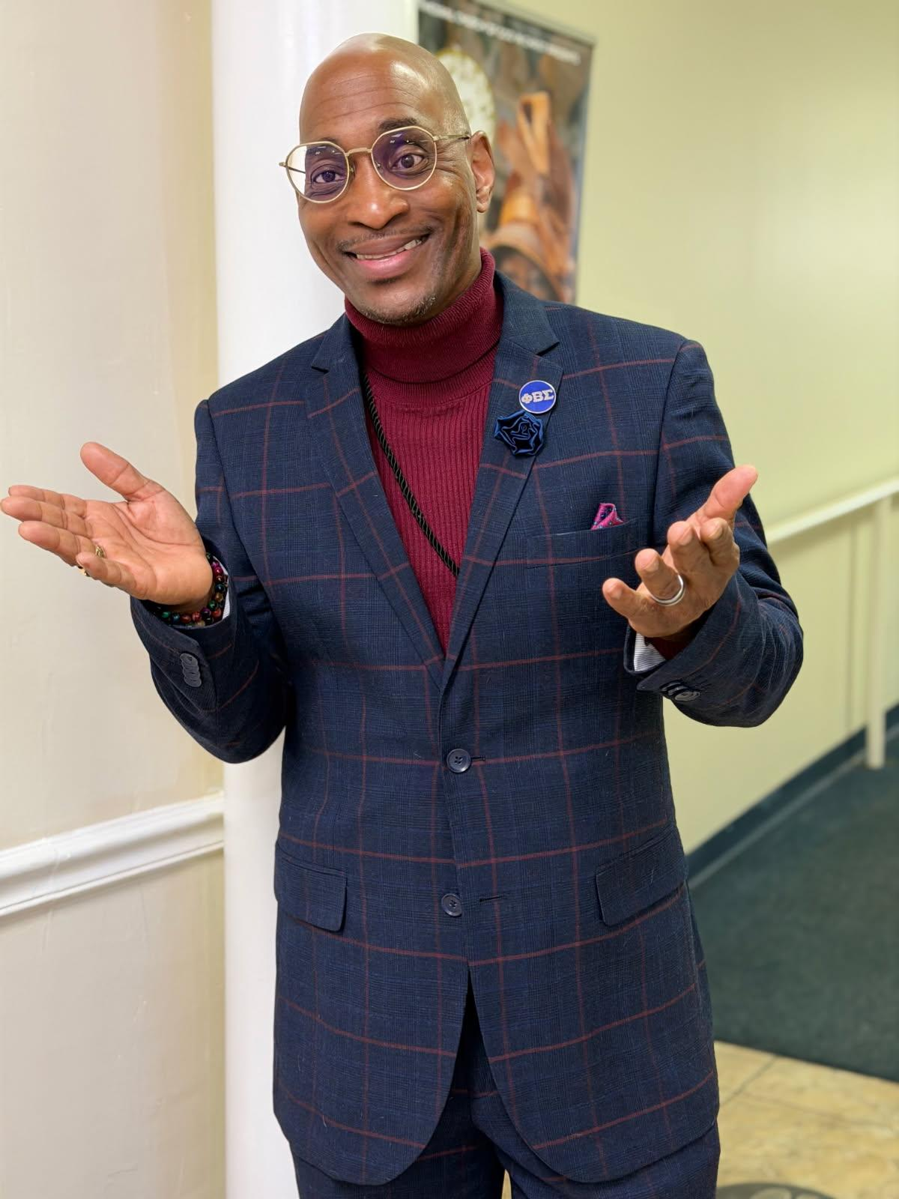

NextGen Rider Rescue Strategy
Lead: Noah Crafts
Stephen Pellicer
Julia Lee
Ensuring Service Continuity During System Transition
Mark Taylor
Presented by the Riders’ Advisory Council
March 4, 2026
Laura Mitchell

Slide 2
Problem and Objectives
Problem: NextGen network will change trips, disrupt habits, and confuse riders.
Objective: Ensure every rider can successfully enter and navigate the new system during transition.
How: Focus on the most vulnerable part of a rider’s trip → the local bus stop
Bus stop closure or service modification
Potential mobility issues
Bus service transitioning to new service model (MARTA Reach)

Slide 3

Overview of Strategy
At Origin Bus Stop
In Transit
At Destination
1
Redirect Riders at Discontinued Bus Stops
2
Mobile Ambassador Grid
3
Temporary Shuttle Bridge
4
Leveraging MARTA Reach

Slide 4
Overview of Strategy
In Transit
In Transit
At Destination
At Origin Bus Stop
At Destination
At Origin Bus Stop
How can we assist riders once they enter the system?

Slide 5
Other Guiding Principles
1
2
3
The new network must run as expected.
Use of resources must be strategic.
Rescue efforts must be temporary.
Notes:
1. Instant Direction Access (No App Required)
Text a route # and stop ID to receive immediate directions to nearest active stop
QR code for instant trip plan
2. Passive Digital Guidance
Solar-powered e-ink display showing: “Your new stop is 3 minutes that way →”
. Visual Pathfinding
Ground decals (colored arrows) physically guiding riders to new stops
Especially helpful for riders with language barriers

Slide 6

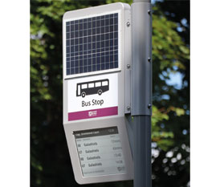
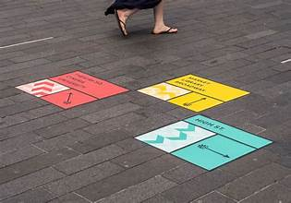
Strategy #1: Redirect Riders at Discontinued Bus Stops
1
2
3
Instant Direction Access
Text route # and stop ID for immediate directions to nearest active stop
Passive Digital Guidance
Solar-powered display showing “Your new stop is 3 minutes away”
Visual Pathfinding
Ground decals or arrows physically guiding riders to new stops
Supports language barriers
Instead of removing stops, temporarily transform them into transition points.
Notes:
1. Instant Direction Access (No App Required)
Text a route # and stop ID to receive immediate directions to nearest active stop
QR code for instant trip plan
2. Passive Digital Guidance
Solar-powered e-ink display showing: “Your new stop is 3 minutes that way →”
. Visual Pathfinding
Ground decals (colored arrows) physically guiding riders to new stops
Especially helpful for riders with language barriers

Slide 7
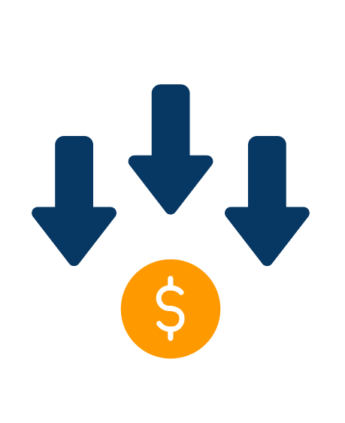


Why This is Innovative and Scalable
COST EFFECTIVE
LOW TECH
TEMPORARY
Rider benefit: Immediate clarity at the exact moment confusion occurs.
Notes:
Low-power, low-cost technology
Temporary deployment
Scalable across hundreds of stops
Rider benefit:
Immediate clarity at the exact moment confusion occurs.

Slide 8
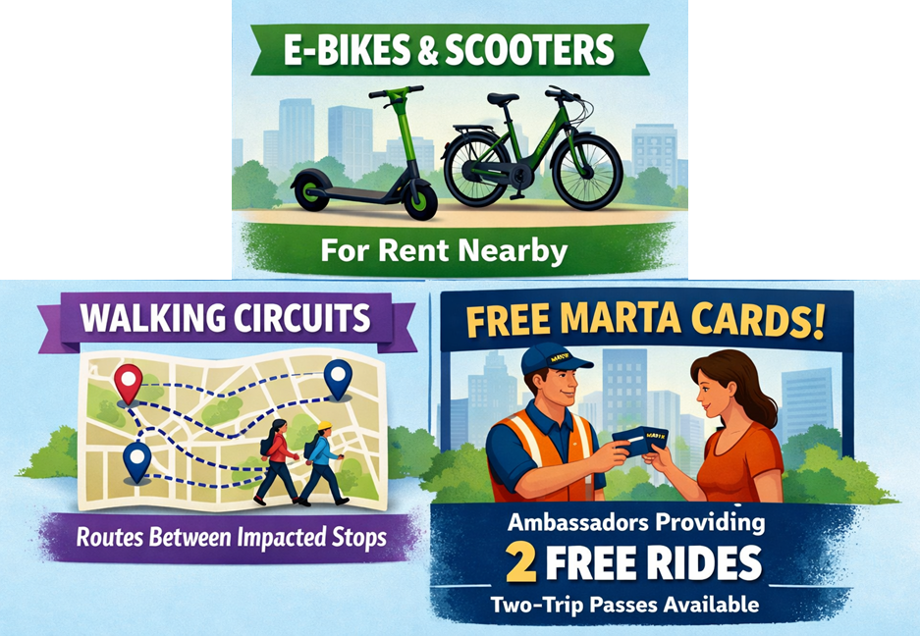
Strategy #2: Mobile Ambassador Grid
Problem: MARTA cannot staff thousands of bus stops.
Solution: Dynamic Mobile Ambassador Grid
Deploy ambassadors to continuously move across affected areas.
Support with a live dashboard highlighting where riders need help most.
Notes:
Buses
E-bikes or scooters
Walking circuits between clusters of impacted stops
Ambassadors can provide free Marta cards for two trips.

Slide 9
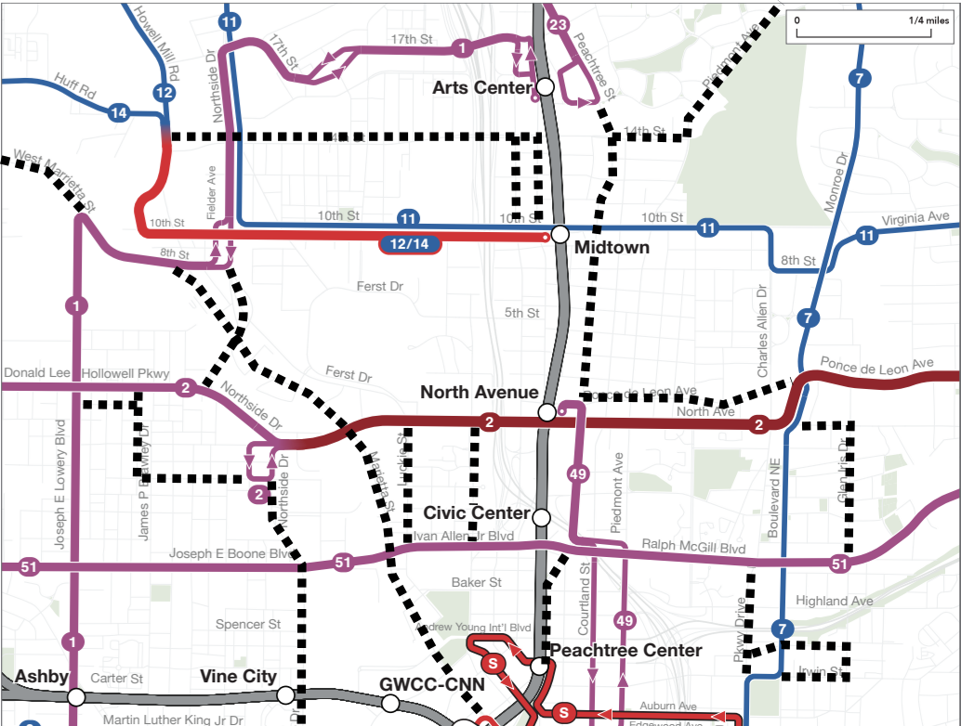
Why This is Innovative and Scalable
Crowd-Signal Response:
If multiple riders scan QR codes or text for help at a specific stop, that location is flagged for ambassador deployment
Why this is scalable:
Small team can cover large area
Resources dynamically allocated where needed most
Rider benefit:
Help appears where and when confusion actually occurs
Streets in Downtown / Midtown with Closed Bus Stops

Slide 10
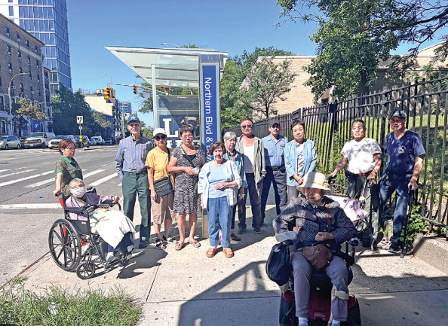
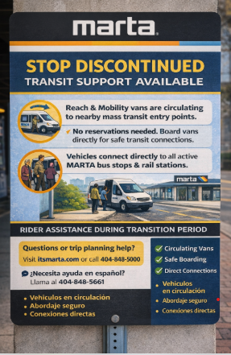
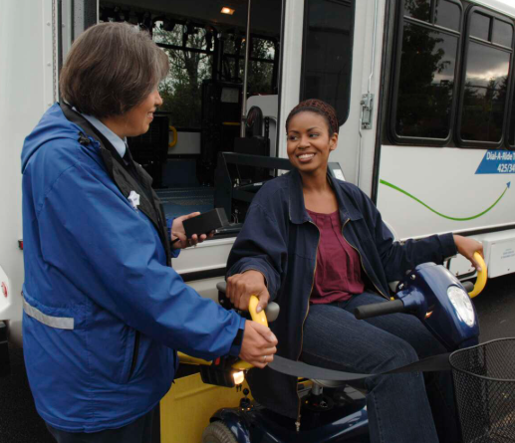
Strategy #3: Temporary Shuttle Bridge
Problem: Some riders cannot
physically reach new stops
Solution: Transition bridge using shuttle vehicles

Slide 11
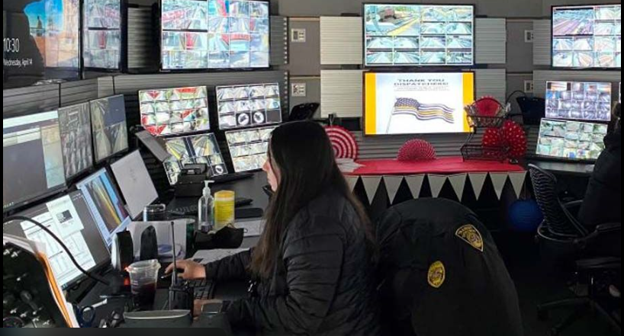
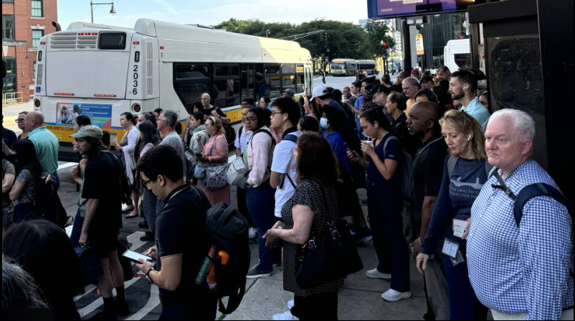
Why This is Innovative and Scalable
Areas with high rider confusion
receive additional shuttle circulation
Uses existing vehicles for
temporary, targeted deployment
Rider benefit: Ensures physical access to system regardless of mobility or awareness.

Slide 12
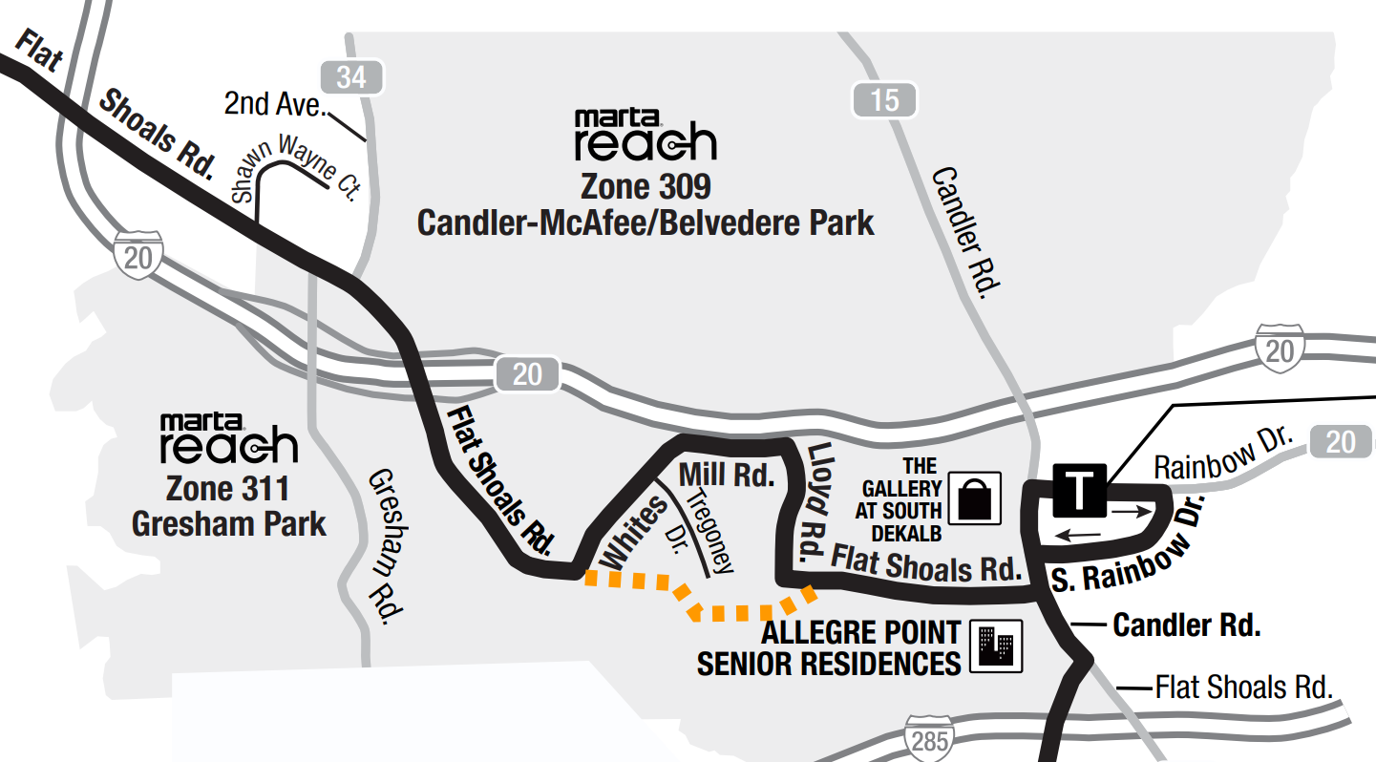
Strategy #4: Leveraging MARTA Reach
Problem: Some routes replaced with new, unfamiliar service model
Solution: Reach vehicles patrol eliminated routes during transition period
Ambassador onboard to:
Teach how to use the Reach service
Redirect riders to new fixed route service
Drop off at nearest active and useful transit stop
Example: Bull Run leg of route 74

Slide 13

Why This is Innovative and Scalable
COST EFFECTIVE
EDUCATION OPPORTUNITY
TEMPORARY
Rider benefit: Assists potentially stranded riders on a route transitioning to Reach.
Notes:
Low-power, low-cost technology
Temporary deployment
Scalable across hundreds of stops
Rider benefit:
Immediate clarity at the exact moment confusion occurs.

Slide 14
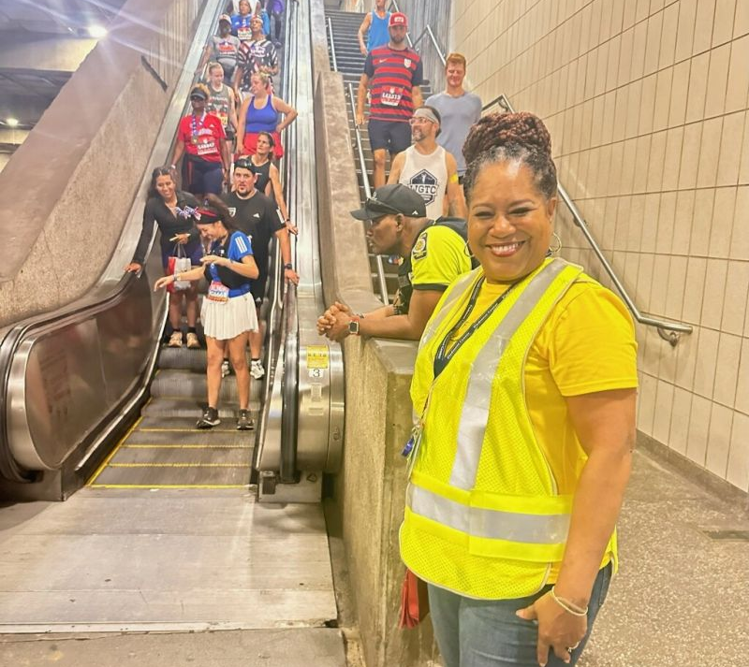
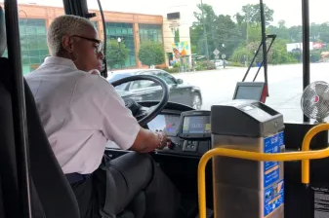
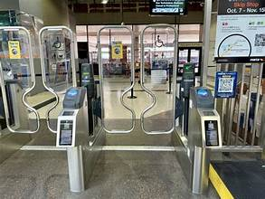
In Transit: Assist Riders in the System
1
2
3
Transition Help Zones at stations and transfer points
Highly visible assistance points
Rapid trip planning support
Operator-enabled rider guidance
Operators trained to identify and assist confused riders
Simple scripts and route crosswalk tools provided
“Stay on Board Guidance” Principle
When unsure, riders are encouraged to enter system first, where help is concentrated
Rider benefit: System becomes self-correcting instead of overwhelming.
Notes:
1. Instant Direction Access (No App Required)
Text a route # and stop ID to receive immediate directions to nearest active stop
QR code for instant trip plan
2. Passive Digital Guidance
Solar-powered e-ink display showing: “Your new stop is 3 minutes that way →”
. Visual Pathfinding
Ground decals (colored arrows) physically guiding riders to new stops
Especially helpful for riders with language barriers

Slide 15
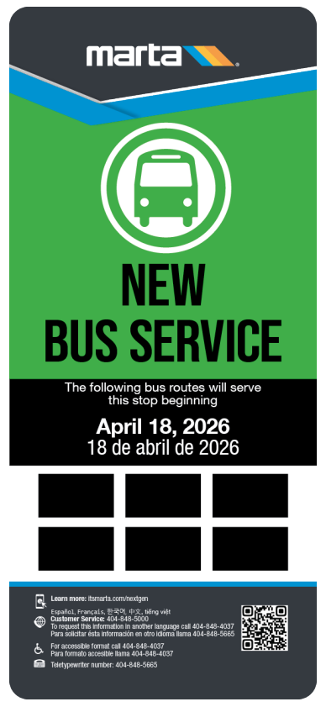
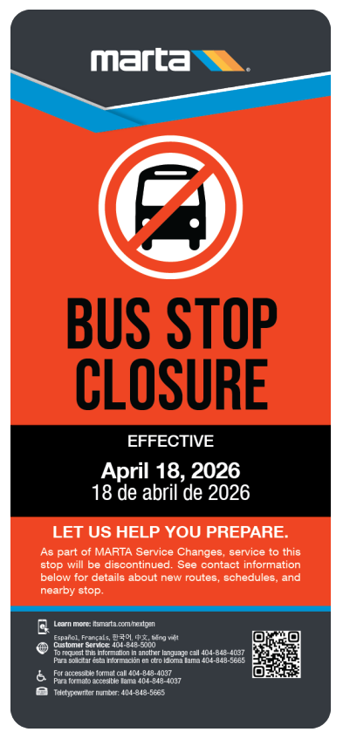
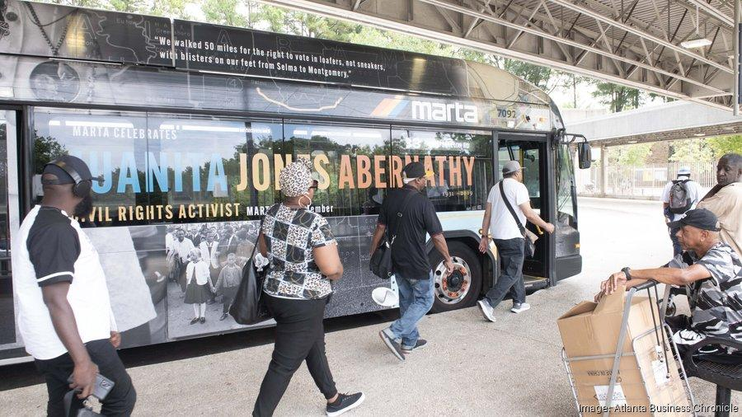
A People First Strategy
NextGen is more than a network redesign.
It is a rider transition moment.
This strategy ensures MARTA successfully carries its riders—not just its routes—into the future.
Notes:
People First means recognizing that transportation is ultimately about the individuals and communities we serve, not just routes, schedules, or infrastructure. When MARTA NextGen prioritizes people first, it ensures decisions are guided by safety, accessibility, dignity, and real community needs — creating a system that builds trust, improves equity, and truly connects people to opportunity.
This is our commitment to our community — a promise that every decision, investment, and improvement begins with people at the center of the work.

